Slide 1


STOCK PRICE PREDECTION
By: Vinay kumar kushwaha
Course: B.Tech/Computer Science

Slide 2

INTRODUCTION
What is
Stock Market?
Stock market price prediction means guessing the future price of a stock. Stock prices change every day based on company performance, news, and demand. In this project, we use past stock data to predict future prices. Machine learning models like LSTM help find patterns in the data.
The main goal is to help investors make better decisions and reduce risk.

Slide 3

PROBLEM
STATEMENT
  Predicting stock market prices is very difficult.
  Prices change continuously over time.
  Manual prediction is not accurate.
  Investors face problems in making the right decisions.

Slide 4

SOLUTION
Stock market is very complex and prices change quickly, so it is difficult for people to make the right decision. Many investors do not have enough knowledge to analyze the market.

Slide 5


OBJECTIVE
  To Predict future stock prices
  To help in decision making
  To plan in advance
  To assist in better Buy/Sell decisions

Slide 6

DATASET
Features used
01
02
03
04
05
Date
Open
High/Low
Volume
Close
Day of trading
when market
opens
Highest/Lowest price of the day
Number of shares traded
Price when market closes
The dataset used in this project is taken from Kaggle, a popular platform for data science and machine learning.
It provides high-quality datasets which are useful for analysis and prediction.

Slide 7


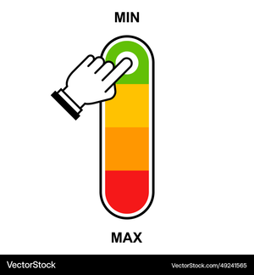

DATA PREPROCESSING
Selected “Close” price for analysis
Normalized data using MinMaxScaler
Create sequences of 5 year for training

Slide 8

Technologies Used
  Python
  Streamlit
  Pandas, NumPy
  Scikit-learn
  Matplotlib

Slide 9

Model Used
  LSTM (Long Short-Term Memory)
  It is a deep learning model
  Best for time-series data like stock prices
  It learns patterns from past data
  Linear Regression
  It is a simple machine learning model
  It predicts values using a straight-line approach

Slide 10
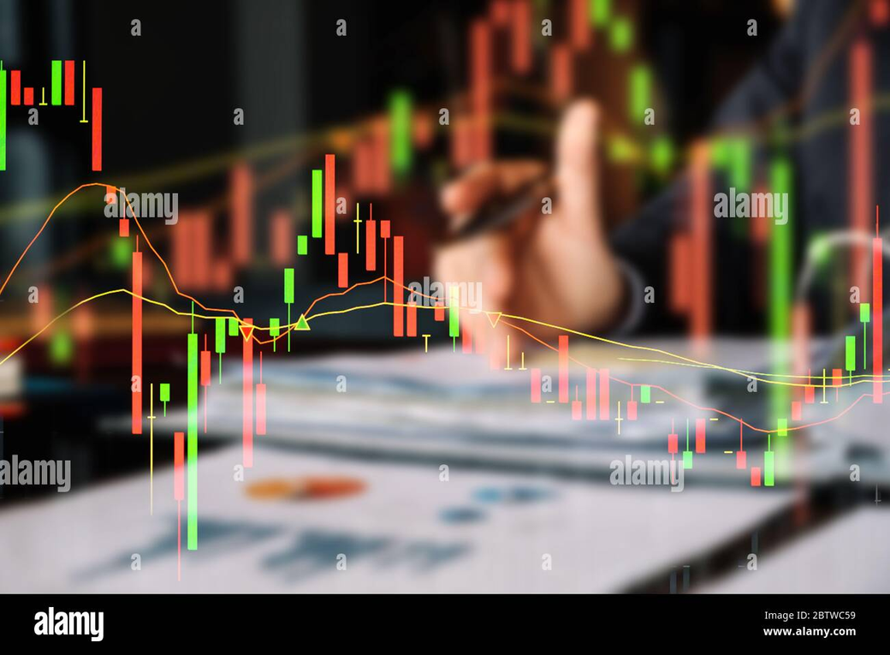
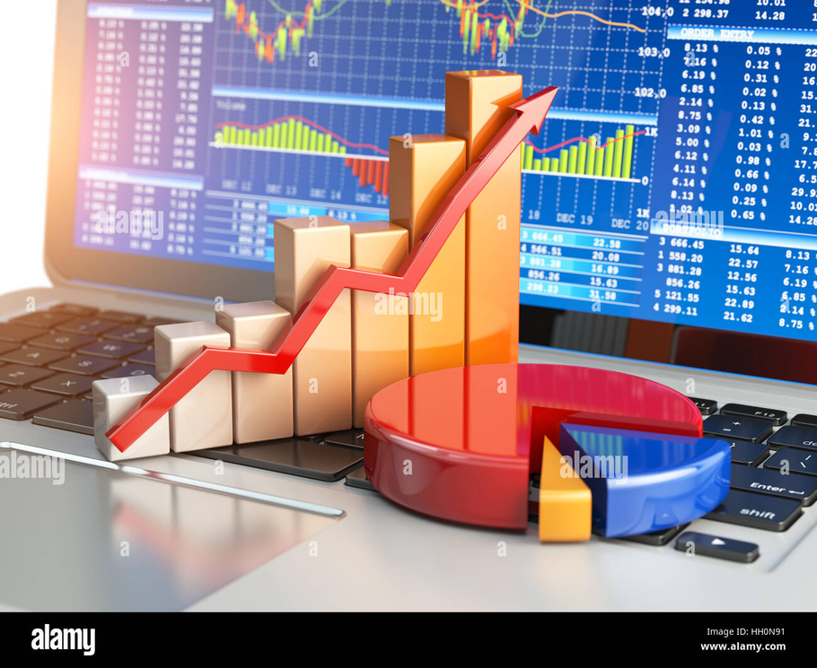

Working Of Model
Take Past Data
Train Model
Predict Next Day Price

Slide 11

Prediction
Output
  Current Price
  Predicted Next Day Price
  Price Change (+/-)
  Buy / Sell Signal 🚦
  Accuracy / Trust Percentage
  Graph of Actual vs Predicted Price
@reallygreatsite

Slide 12

Visualisation
Line Chart
Candlestick Chart
Actual vs Predicted Graph
Pie Chart for Buy/Sel

Slide 13

Results
The model analyzed past data
Predicted future prices
The graph shows a clear trend
The prediction is quite accurate
Useful for investors

Slide 14
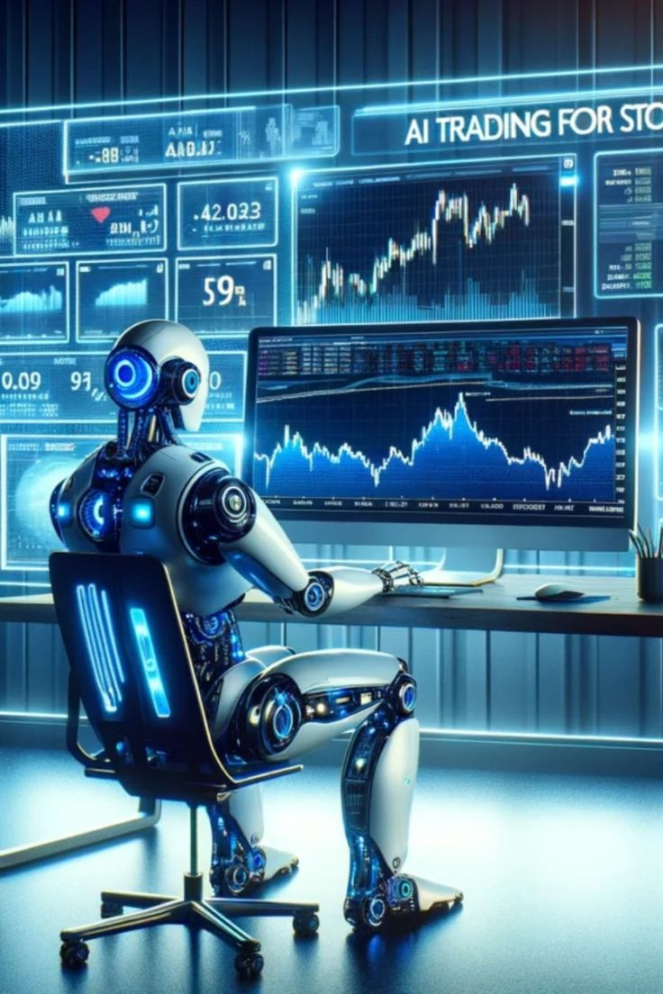
FUTURE WORK
  In the future, this project can predict stock prices for multiple days instead of just one day.
  It can be improved to give more accurate results using better models.
  Real-time data can be added for live predictions.
  More companies and global stocks can be included.
  The system can give smart buy/sell suggestions to users.
  It can be converted into a mobile or web application for real users.

Slide 15

Conclusion
  This project makes stock prediction simple
  It saves time and effort
  Gives quick results
  Easy to use and understand
  Helpful for making better decisions

Slide 16

THANK YOU!

